Slide 1
PC Maintenance: Preparing for A+ Certification
Chapter 9: Working with the BIOS Setup Program

Slide 2
Chapter 9 Objectives
Identify the purpose of the system BIOS
Access BIOS Setup utilities
Know what settings to change in BIOS Setup for specific situations
Install a BIOS update
Replace a BIOS chip

Slide 3
BIOS
Basic Input Output System
Motherboard has a BIOS
Other devices may also have a BIOS (ex. printer, network router, video card)
Typically stored on a ROM or Flash RAM chip

Slide 4
CMOS
Complementary Metal Oxide Semiconductor
Type of RAM used for storing exceptions to BIOS settings
Powered by motherboard battery full-time

Slide 5
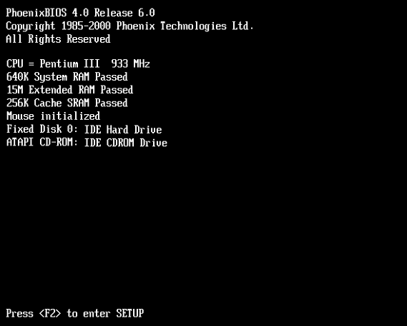
Accessing BIOS Setup
Watch for a message at startup telling which key to press

Slide 6
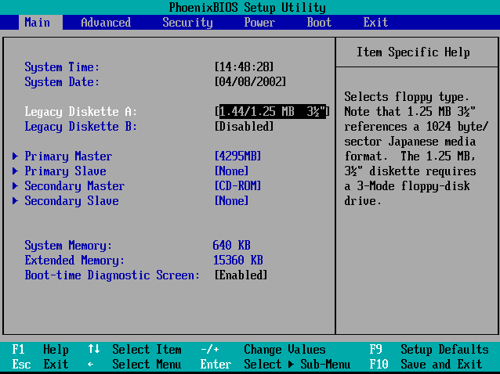
BIOS Setup Utility

Slide 7
Exiting BIOS Setup
Refer to message onscreen for instructions
F10 is typical for saving changes
Esc is typical for discarding changes

Slide 8
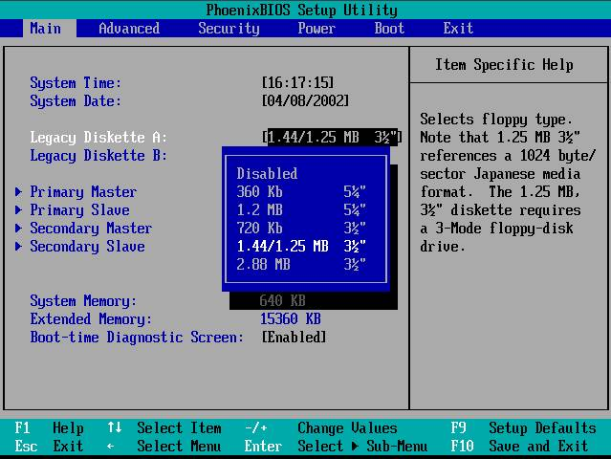
Floppy Drive Configuration
BIOS does not typically detect floppy drives

Slide 9
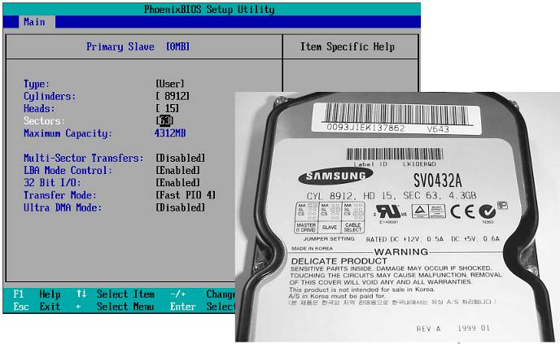
Hard Drive Configuration
Usually Plug-and-Play, but manual setup is possible; refer to label on disk drive

Slide 10
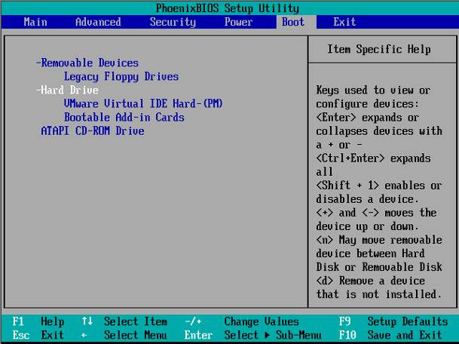
Boot Configuration
Set boot order (CD, Hard, Floppy, etc.)

Slide 11
Plug and Play
When Plug and Play OS is assumed, BIOS relinquishes control of many hardware resources
Reset Configuration resets BIOS assignments of resources from its own Plug and Play
Assign IRQ for USB support enables USB devices to work before OS loads

Slide 12
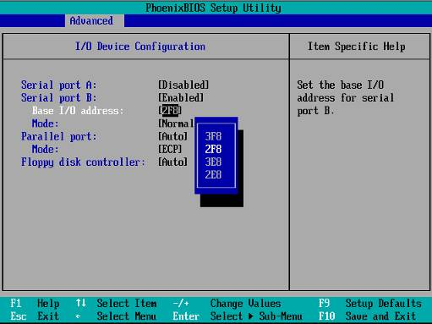
Integrated Peripherals
Legacy parallel and serial ports
Set addresses or enable/disable

Slide 13
Power Management
Can be configured in BIOS or in OS
OS is preferable if possible
Power management turned on in both places can result in conflicts

Slide 14
Recover from Bad BIOS Changes
Find reset jumper on motherboard
Change its position
Power system on for 5 to 10 seconds
Power system off
Reset jumper

Slide 15
Install BIOS Updates
Download update from manufacturer’s Web site
Check instructions on Web site
Many types of updaters
  Command line utilities
  Windows-based utilities
  Boot disks

Slide 16
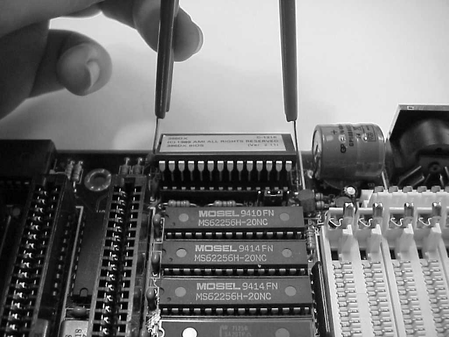
Replace BIOS Chip
Pull chip with chip puller tool

